Slide 1
COBBER E-STORE
By: Amira, Oriana, Elias

Slide 2
Overview
Introduction
The Mechanics of the e-store
Payment Structure
Running the Project
Unique challenges
Further Improvements to be Made

Slide 3
Introduction
What is this project all about?
Simulating an E-store Cobber website

Slide 4
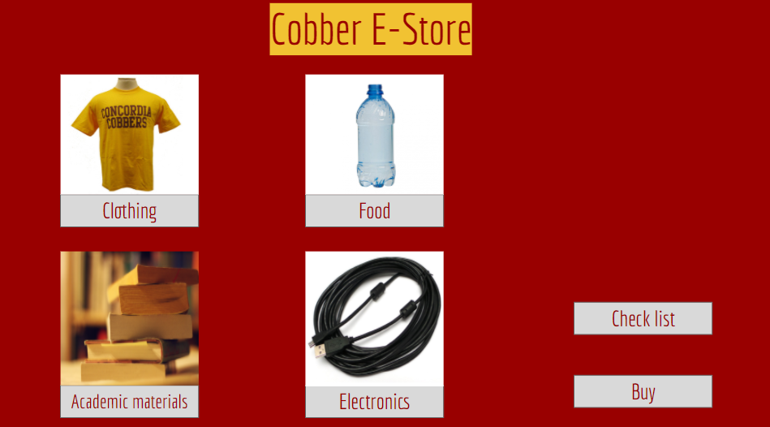
THE MECHANICS OF THE E-STORE
Jframe Structures
Return Buttons

Slide 5
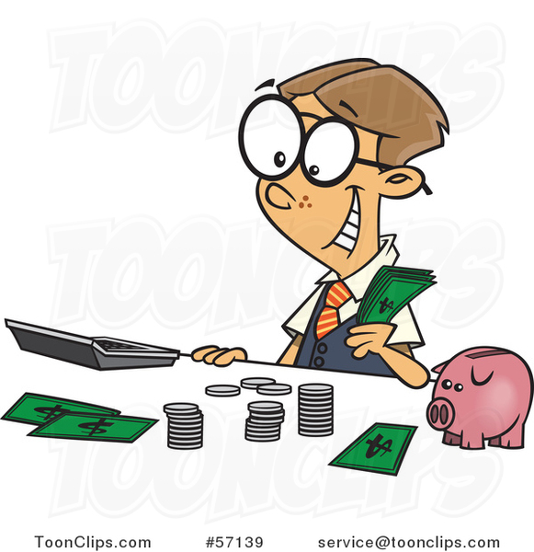
PAYMENT STRUCTURE
CASH HANDLING
Payment occurs by cash.
“ADD TO CART” BUTTON
Marks every selected item into a new jFrame and calculates the total cost.
BUY BUTTON
Buys the product and leaves a receipt with a thank you note.
Notes:
https://www.google.com/url?sa=i&url=https%3A%2F%2Ftoonclips.com%2Fdesign%2F57139&psig=AOvVaw0gD6KJKAksf_5Wqt-BrNeN&ust=1619679240273000&source=images&cd=vfe&ved=0CA0QjhxqFwoTCPj3ncitoPACFQAAAAAdAAAAABAP

Slide 6
RUN THE PROGRAM

Slide 7
STRENGTHS OF THE PROGRAM
Design
SWITCHABLE JFRAMES
The transitions from Jframe to Jframe is smooth
There is a superb use of Jpanels to give the frames more color and attractive
Variety of Products
Organization of the products in sections
Gives a lot of options for users to choose
The creation of many compartments allow users to move to be more specific with their “program search.”

Slide 8
Further improvements to be made
Improve the windows
Use of databases
Payment structure
Having nested for JFrames
Having static Buy and AddToCart buttons that allow a smooth flow of data between frames
Having a database that accounts for all the products.
Accounting for quantity of the products to avoid unlimited stock
Cash payment
Electronic Payment methods including credit/debit cards.

Slide 9
UNIQUE CHALLENGES
PROJECT RELATED CHALLENGES
Learn how to Connect multiple J-frames together
Figuring out the Payment Structures
Time Constraint (due dates)
TEAM RELATED CHALLENGES
Cooperation and Coordination
Time Management
Application of a Creativity
Not biting more than we can chew (Limited Knowledge)

Slide 10
THE COBBER E-STORE
Amira Mohamed, Elias Nkuansambo and Oriana Penaloza

